Slide 1
Kubernetes Architecutre

Slide 2
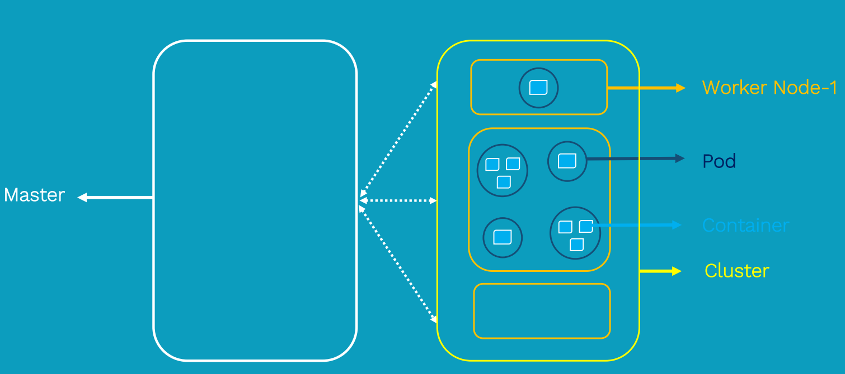
Kubernetes Architecture

Slide 3
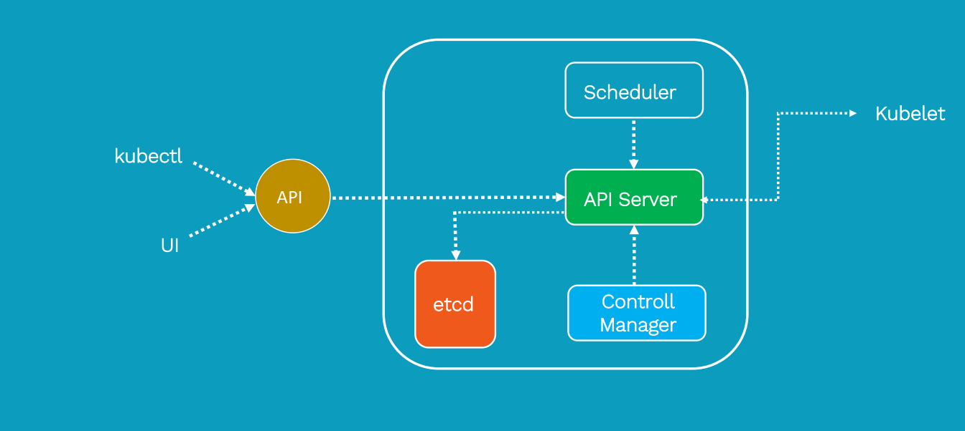
Kubernetes master components

Slide 4
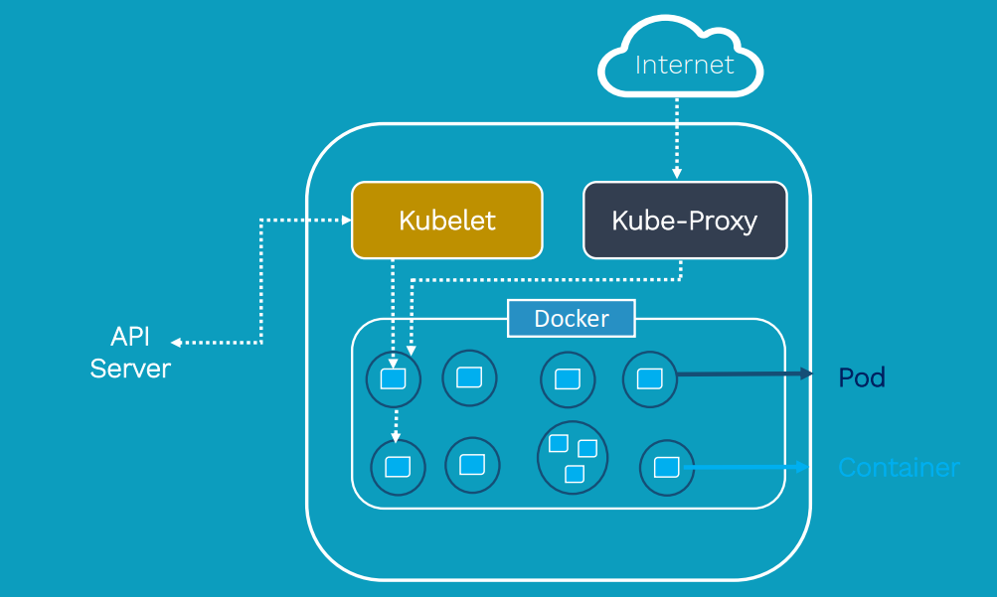
Worker nodes components

Slide 5
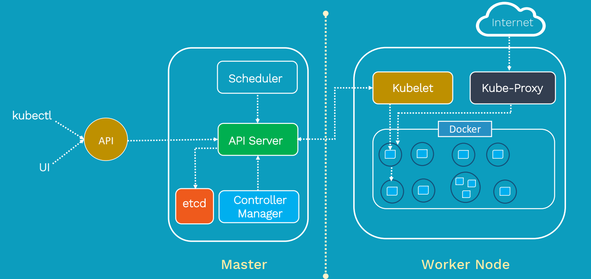

Slide 6
Kubernetes Installation
There are various ways we can start working with Kubernetes.
Play-with-Kubernetes
Minikube
Configuration from scratch on servers

